Slide 1

Sydney
Level 3, 55 Regent Street
Chippendale, NSW 2008
Phone:+61 2 9318 8171
Email: py@eca.edu.au
Melbourne
Level 7, 399 Lonsdale Street
Melbourne, VIC 3000
Phone:+61 3 9603 5333
Email: enquirepy@eca.edu.au
Brisbane
Level 1, 126 Margaret Street
Brisbane, QLD 4000
Phone:+61 7 3210 7450
Email: enquirepy@eca.edu.au

Slide 2
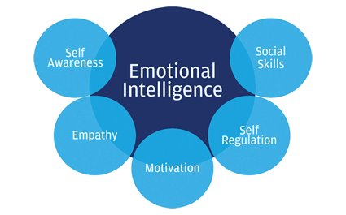
Emotional Intelligence
Learning Objectives:
To understand what Emotional Intelligence is (EI)
To define and its five elements
To self-reflect on own EI
Complete the quiz and discuss answers
Understand ways to Increase your EI

Slide 3
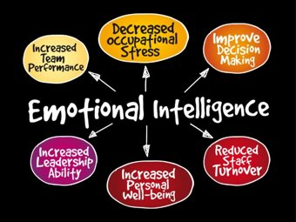
Emotional Intelligence
1. What do you think Emotional Intelligence is?
2. What is more important IQ or EI?

Slide 4

Emotional Intelligence
"In the last decade or so, science has discovered a tremendous amount about the role emotions play in our lives. Researchers have found that even more than IQ,​
your emotional awareness and abilities to handle feelings will determine your success and happiness in all walks of life, including family relationships."​
-John Gottman

Slide 5
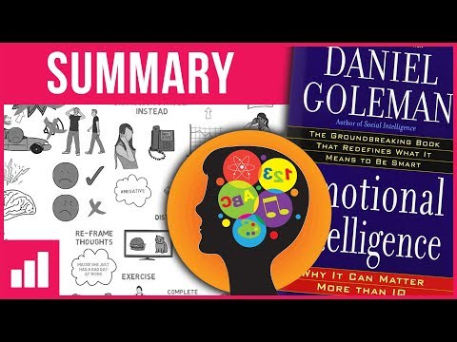
Emotional Intelligence
Daniel Goleman Introduces Emotional Intelligence – 5min
https://www.youtube.com/watch?v=Y7m9eNoB3NU

Slide 6
Emotional Intelligence
Emotional Intelligence - How to Lead with Emotional Intelligence – 18min https://www.youtube.com/watch?v=dCIgOYY4NKc

Slide 7

Emotional Intelligence
Let's Learn more
Emotional Intelligent Article
https://www.mindtools.com/pages/article/newCDV_59.htm

Slide 8
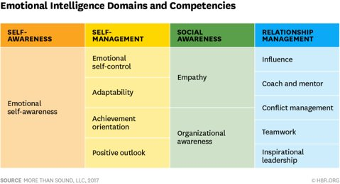
Emotional Intelligence
The Reflective Learning Process
Activity
Think about the EI Elements and Reflect on how well you think you perform in this element and what you can do to improve in this area
Share your reflections with others
(in a group of 2 or more)
and ask them for advice on what
you can do to get better in this element

Slide 9
Emotional Intelligence
Identify a situation you encountered in your work or personal life that you believe could have been dealt with more effectively
Describe the experience
What happened? When and where did the situation occur? Any other thoughts you have about the situation?
Reflection How did you behave? What thoughts did you have? How did it make you feel? Were there other factors that influenced the situation? What have you learned from the experience?
Theorizing How did the experience match with your preconceived ideas, i.e. was the outcome expected or unexpected? How does it relate to any formal theories that you know? What behaviors do you think might have changed the outcome?
Experimentation Is there anything you could do or say now to change the outcome? What action(s) can you take to change similar reactions in the future? What behaviours might you try out?

Slide 10
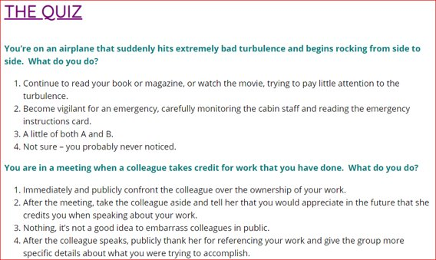
Emotional Intelligence Quiz
The following 10 question quiz is designed to give you a general idea of how much you currently know about being emotionally intelligent

Slide 11
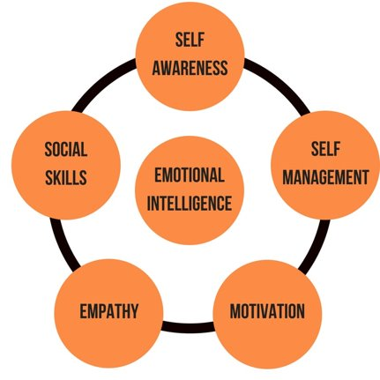
5 Ways To Develop Your Emotional Intelligence
1. Manage your negative emotions
2. Be mindful of your vocabulary
3. Practice empathy
4. Know your stressors
5. Bounce back from adversity

Slide 12
What I learned today: Assessment
Summary /Reflection
Instruction: Summarise what you have learned today
Emotional Intelligence Plan
Design a personal 6-month Plan on ways you can Improve your Emotional Intelligence

Slide 13
Do you have any questions?
Sydney
Level 3, 55 Regent Street
Chippendale, NSW 2008
Phone:+61 2 9318 8171
Email: py@eca.edu.au
Melbourne
Level 7, 399 Lonsdale Street
Melbourne, VIC 3000
Phone:+61 3 9603 5333
Email: enquirepy@eca.edu.au
Brisbane
Level 1, 126 Margaret Street
Brisbane, QLD 4000
Phone:+61 7 3210 7450
Email: enquirepy@eca.edu.au

Slide 14

Thank you
Sydney
Level 3, 55 Regent Street
Chippendale, NSW 2008
Phone:+61 2 9318 8171
Email: py@eca.edu.au
Melbourne
Level 7, 399 Lonsdale Street
Melbourne, VIC 3000
Phone:+61 3 9603 5333
Email: enquirepy@eca.edu.au
Brisbane
Level 1, 126 Margaret Street
Brisbane, QLD 4000
Phone:+61 7 3210 7450
Email: enquirepy@eca.edu.au

